Slide 1

Agency Webinar
Scaling Reputation Management:
Effective Growth, Nurture & Retention Programs
Notes:
Welcome to this month’s webinar. GatherUp is excited to host this agency-specific webinar on scaling reputation management, providing tips for effective growth, nurture & retention programs.
We will be emailing out the recording and slides. Feel free to drop any questions you have in the chat or Q&A and we’ll get to them either in the moment or at the end.
Make sure you visit our webinars page at Gatherup.com for news on the next webinar, scheduled for June 18th. Content and guests TBD.

Slide 2




GatherUp is the one platform that scales all aspects of your reputation management from listening to customers to understanding them to engaging with them so you can improve the customer experience across multiple businesses.
Listen
Understand
Engage

Slide 3


Agenda
Building a Solid Foundation
Acquisition Strategies
Activation and Onboarding Best Practices
Retention Strategies for Long-Term Success
Notes:
Let’s introduce our guests on today’s webinar.

Slide 4
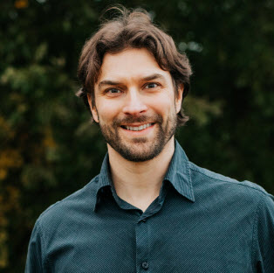


Brian Urban
Founder of CounselEAR
Former owner of Advanced Hearing and Balance Center
Past President of the Academy of Doctors of Audiology
Notes:
Brian Urban is Founder of CounselEAR and a former owner of an audiology clinic himself. Brian thanks for being here and tell us more about CounselEAR.

Slide 5

Matt Saeger
Vice President of Customer Experience
Over a decade of experience supporting, implementing, and fostering the growth of SaaS-based applications
Notes:
Matt is the VP of Customer Experience at GatherUp, overseeing both customer support and account management. Matt, tell us about your role here and your experience helping businesses grow.

Slide 6


Steve Hartman
GatherUp team member for over four years
Host of monthly GatherUp webinars
Connective tissue between customers and the product, CS, sales and marketing teams

Slide 7

Building a Solid Foundation for Growth
Get your foot in the door
Notes:
For our agency and reseller partners we know growth is such a challenge.

Slide 8
Get a Foot in the Door

Slide 10
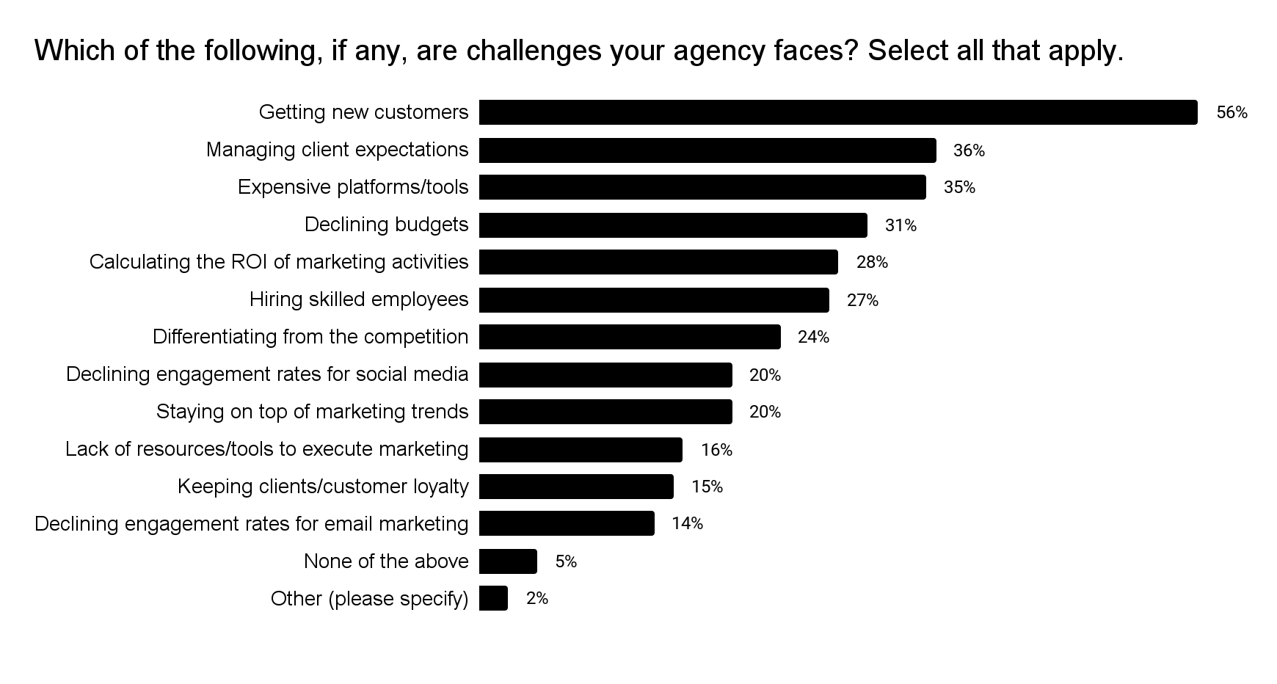
Agency Challenges
Notes:
Last summer we surveyed agencies on many topics. One of which was the biggest challenges. Getting new customers consistently comes up as the top challenge among our agencies and resellers. Brian, what challenges do you see when it comes getting new clinics on board?
What is it about client expectations that is so challenging?

Slide 11
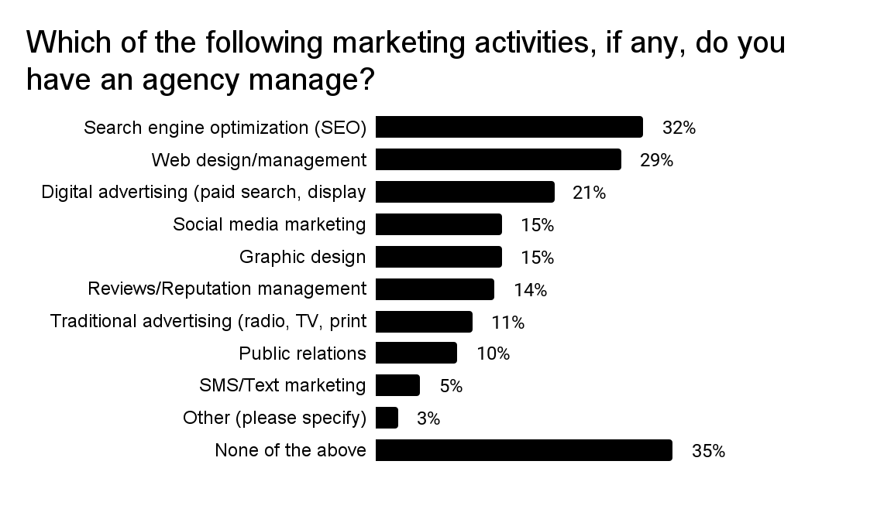
We asked small businesses
Notes:
We also surveyed small business owners and also asked a series of questions, one of which was related to activities that they have an agency manage. The top two activities were SEO and web design. Those can be longer cycles to get to first value. It’s hard to address all of this at once. So one approach can be to start with reviews.

Slide 12
Reputation is your foot in the door
SEO and website design can be long-term projects
Marketing Automation
SMS or Loyalty Marketing
Notes:
Brian, you offer marketing automation, but when it comes to new customers, where does review management land on the order of importance ?

Slide 13
Importance of Reviews
In addition to the immediate impact and helping with local search, reviews are important to your company because:
96%
of U.S. consumers
read reviews
66%
of consumers stated that many online reviews make them trust a brand online.
75%
of people have looked online to find out about a doctor, a dentist, or medical care.
2
Notes:
How do you express the importance of getting reviews? And then how do you convey the benefits of a software to create a program at scale?
Even if you’re not a marketer a simple starting point is to ask for a review. https://moz.com/local-business-review-survey-report/habits-of-review-writers
(Show statistic on # of people who don’t get a review.)

Slide 14
Value of
Automation
Most small business owners aren’t marketers by trade
Need assistance upfront
Consistent review acquisition with consistent responses and peace of mind
86%
of respondents write at least some reviews
39%
of review writers have not received a direct review request in the past 5 years
https://moz.com/local-business-review-survey-report/habits-of-review-writers
Notes:
Even if you’re not a marketer a simple starting point is to ask for a review.
(Show statistic on # of people who don’t get a review.)

Slide 15
Internal Team Structures
Supporting Growth
Human Capital
Technology
Is the team bought in?
Set a threshold for number of clinics/clients per staff member
Track and Predict
Notes:
You’re starting to sell this. What are you doing internally to support that growth?
Need leadership buy-in to achieve growth goals
Steep learning curve.
Audiologists don’t have a lot of business experience. Early gains. Clinics not collecting any reviews. Email marketing automation.

Slide 16

Acquisition & Onboarding
Onboarding is the bridge from sales to realized value.
Notes:
Once you’ve built a foundation that reviews and reputation management can be a great foot in the door, the acquisition and onboarding phase becomes extremely important.

Slide 17
Partner in Success
Training protocols and activities
Question & answer sessions
Check in calls
Make sure all parties are ready to go live
Notes:
Many of our clients are not techies, and again are not marketers. Brian, talk about the systems CounselEAR has in place to make for great onboarding experience.
Green light system. Not going live until they’re ready.

Slide 18
Onboarding
The bridge between sales & value
Onboarding doesn’t have to be the whole product
Solve problems in pieces
Business solutions — compliance, financials, legal, etc.
Notes:
Matt, talk to the audience about GatherUp’s onboarding strategy.
Means to solve the immediate problem.
Onboarding in pieces.
Value might be

Slide 19
Show Immediate Value
Celebrate successes
Show the value to the bottom line
Establish baselines in review generation
Notes:
Achieving success in the training protocols.
Milestone emails!

Slide 20
Look Beyond the Initial Offering
Consider the full customer journey
Map out a plan but start simple
Engage early and often
Notes:
Compliance, claims in on time.
Timelines driven by the clinic.
Optimizing reviews
How are you handling negative reviews? Don’t review gate!

Slide 21
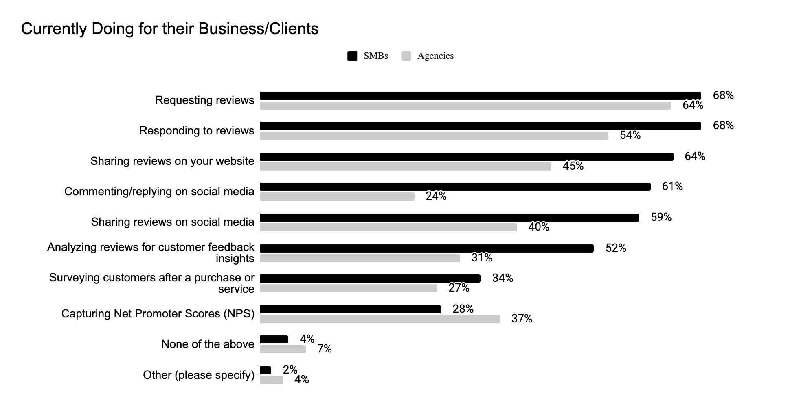
Bring More Reputation Value
Notes:
Highlighted areas show big gaps between what SMBs are doing and what Agencies are doing.
These could be areas to bring value.

Slide 22
Setting Goals
Reputation specific goals
Review volume
Average rating
Content (website & social)
Aggressive but realistic
How do they ladder up to business goals

Slide 23
Make or break on first value
Start small
Create a specific roadmap
Highlight successes
Over communicate to identify problems early
Notes:
What’s a good barometer for communication? How often, or at what key moments in time?

Slide 24

Retention Strategies for Long-Term Success
Desired outcomes require constant iterations

Slide 25
Discover NEW Problems & Solutions
Collect and organize questions received by support
Check in calls
Maintain regular contact
Notes:
Once the client is onboarded and using the review process, how do you expand in other areas to add value?

Slide 26
Constant Iterations
Train support/CS on new features
Pair new features with problems to solve
Make it easy for them to adopt new features
Notes:
Onboarding is never done. How do you continue to engage clients and hold them accountable?

Slide 27
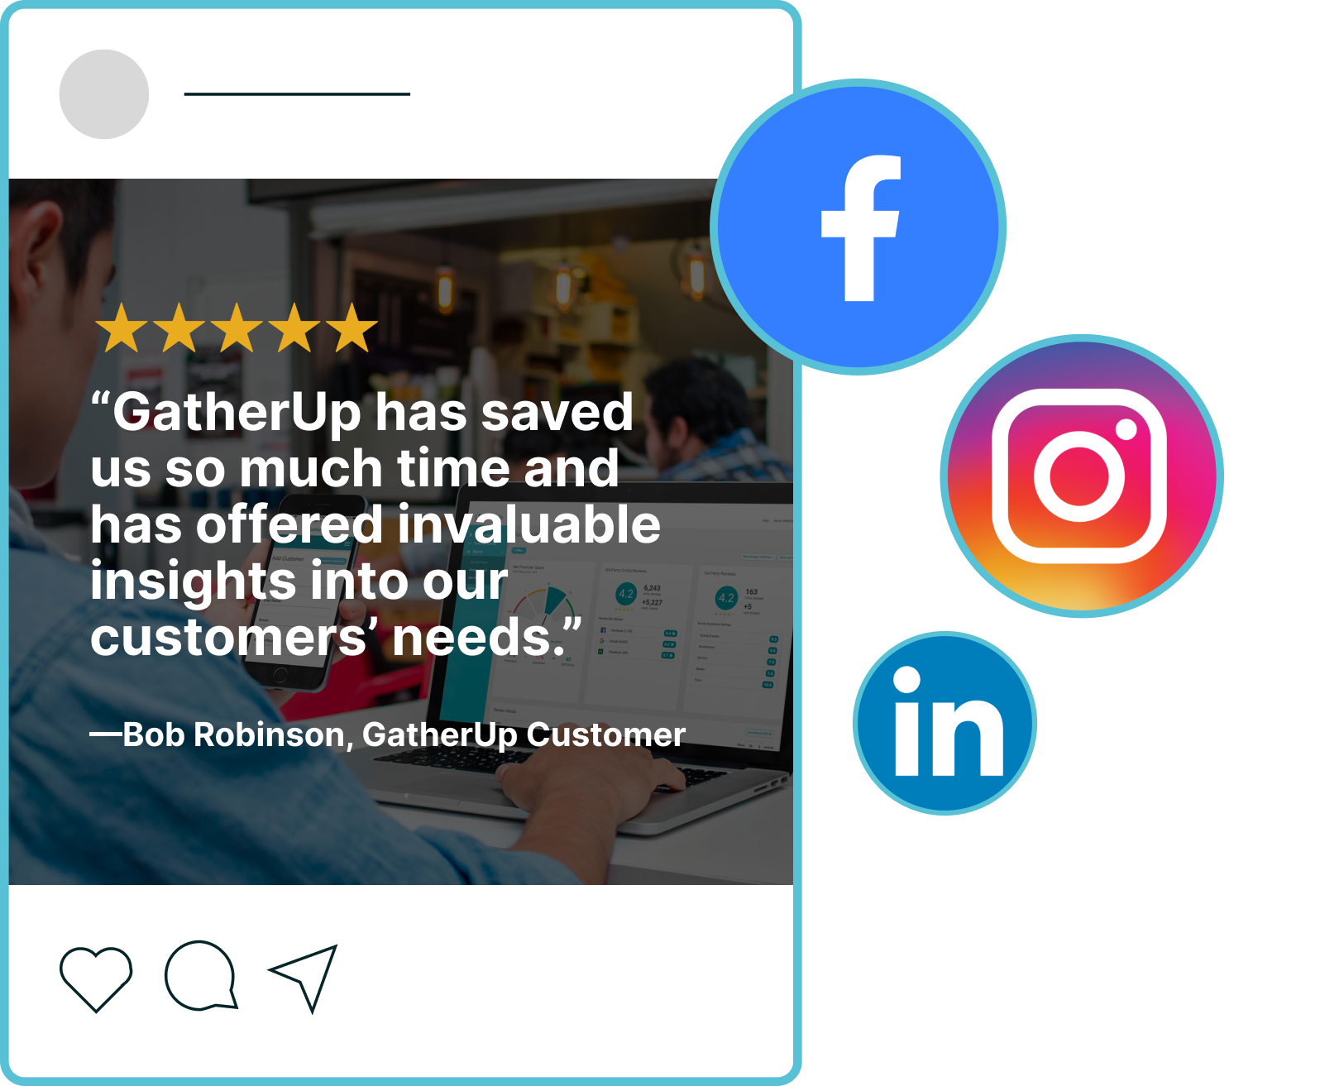
Stay Engaged
Create a regular engagement point
Feature Friday series
Social media
E-newsletters

Slide 28
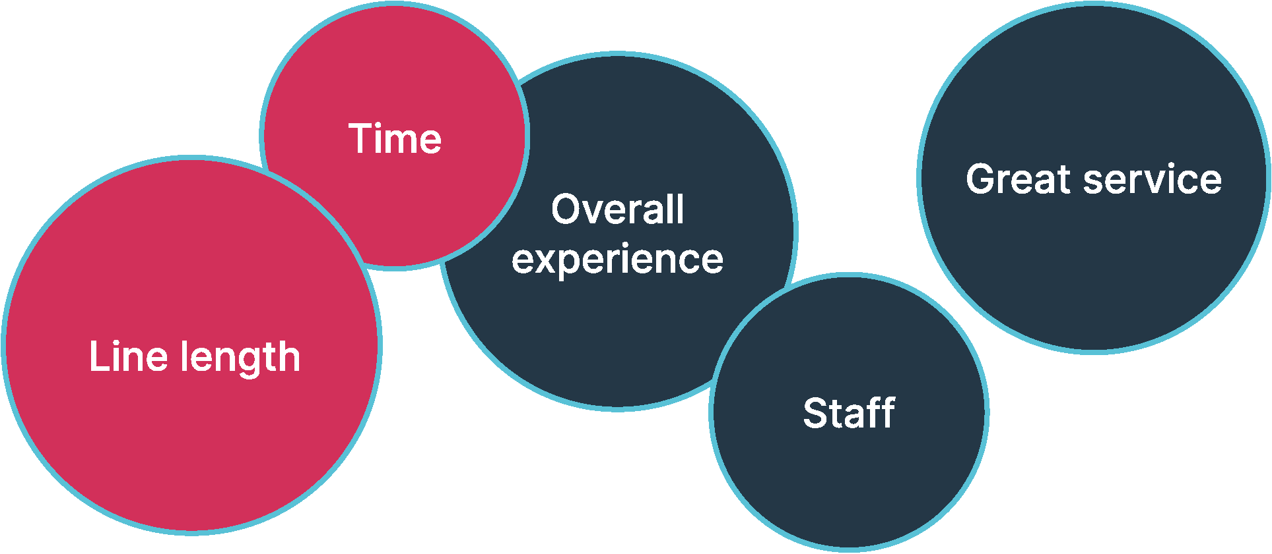
Track Metrics that Show Value
Review volume & rating
Is every patient/customer getting a request?
Response rates
Sentiment
Specific areas of focus or new products/services
Notes:
This can also be broken out during the roadmap and planning process? Zero to some. Some to many.

Slide 29

Recap

Slide 30
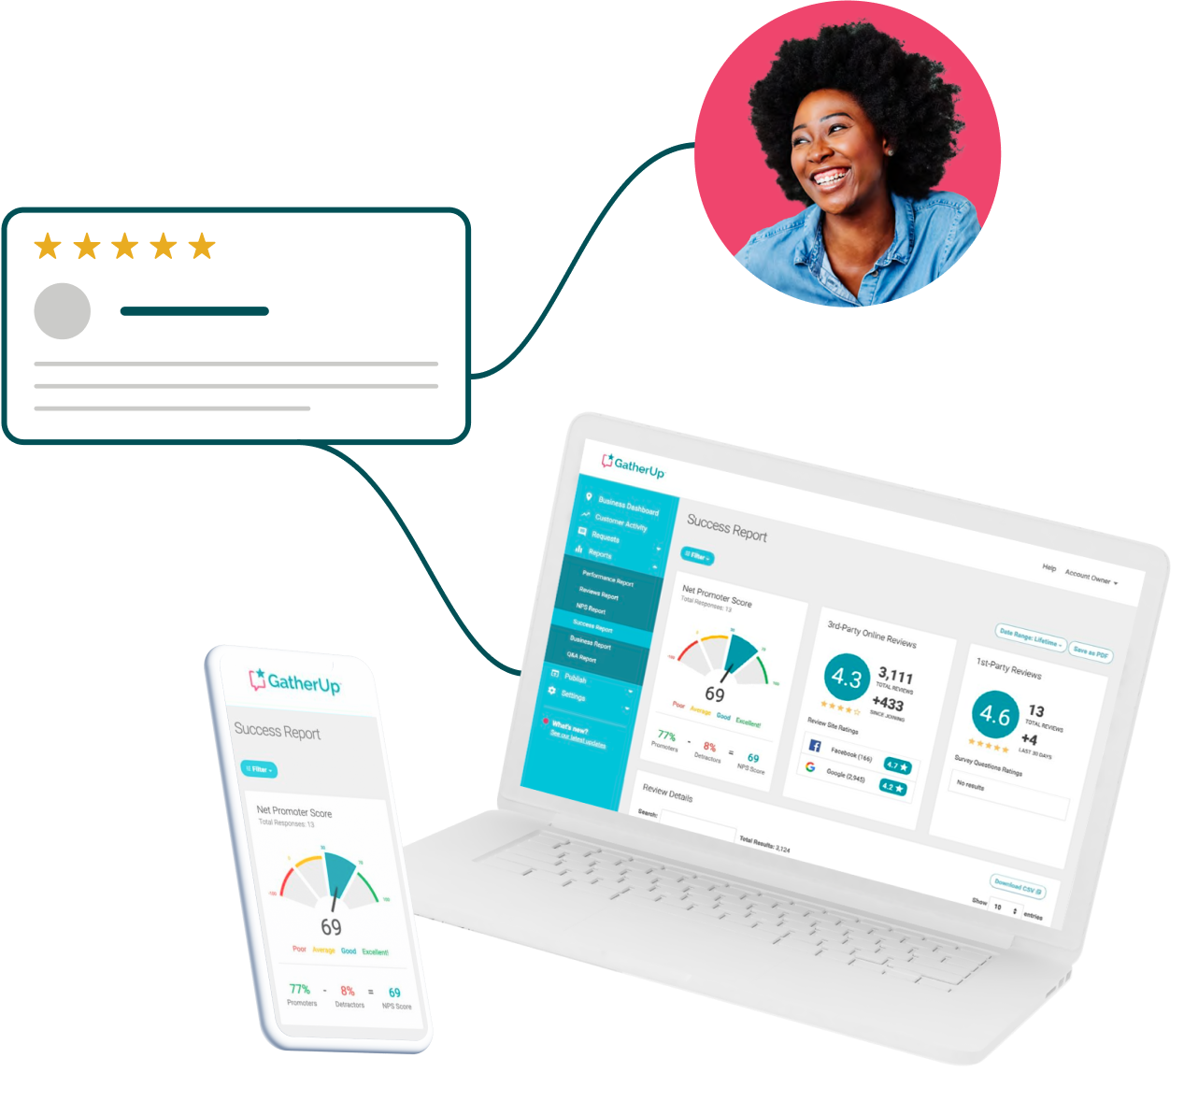




Takeaways to help you win in 2024
Clear processes
Onboarding is never done
Maintain communication cycle
Every touchpoint becomes about solving a problem

Slide 31
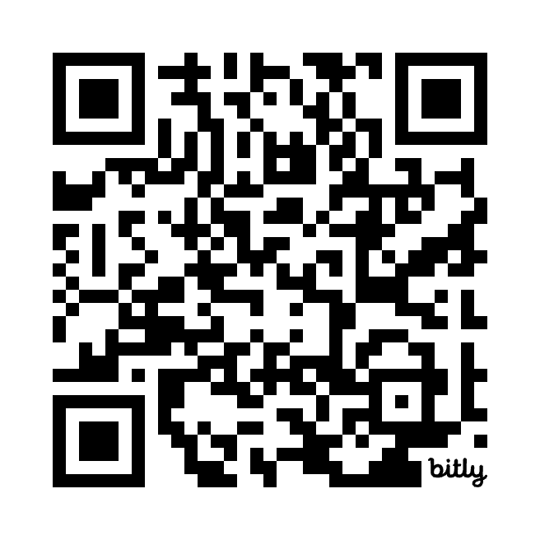
Thank You
Brian Urban
Co-founder & President, CounselEAR
Download our Review Management for Agencies eGuide:
http://bit.ly/4aumS1G
Matt Saeger
VP of Customer Experience, GatherUp
matt.saeger@bytraject.com
Notes:
With that, any final questions?
Thanks again for joining us.

